Slide 1
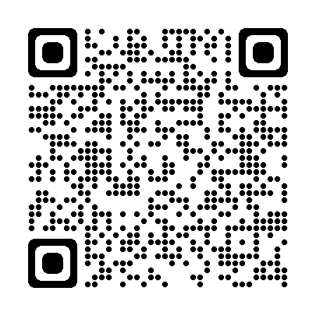
Japan Common ICF Template
March 3, 2023 (2D barcodes Updated)
01. About the Common ICF Template
References
Background
Many companies and organizations have worked to improve the Informed Consent Forms (ICFs) prepared by trial sponsors from the perspective of "patient-oriented wording" and "compliance with regulatory requirements in Japan".
However, for the following reasons, improving sponsors’ ICF templates alone has not sufficiently improved the actual ICFs provided to patients, and various problems have been identified, forcing both medical institutions and sponsors to still spend considerable time preparing site-specific versions of ICFs.
- Different sponsors have different ICF templates. - Some medical institutions have their own ICF templates.
Efforts of R&D Head Club
To investigate these issues about ICFs in Japan, R&D Head Club led a fact-finding survey in 2021, with the results made public at the "Conference on CRC and Clinical Trials", "DIA Japan Annual Meeting”, etc., while discussing the feasibility of a common ICF template in Japan and promoting efforts for its realization.
In 2022, a task team was established, consisting of investigators, CRCs, trial secretariat personnel, IRB members, patients, the Japan Medical Association Center for Clinical Trials staff, etc., to reflect opinions of all parties, leading to issuance of the initial version of the Japan Common ICF Template in October 2022.
Fact-finding Survey on Informed Consent Forms
(2021)
For ICF Standardization in Japan (2022)
Participating members
Advisors
Nihon University Itabashi Hospital | Yukiko Enomoto
Japan Medical Association Center for Clinical Trials | Yukiko Maruyama
National Hospital Organization Headquarters | Naoki Kondo
The University of Tokyo Hospital | Kaori Watanabe
Reviewers
National Hospital Organization Headquarters | Chie Takeshita Mayo Kurobe Takako Arai
National Cancer Center Hospital East | Yukie Kimura
National Cancer Center Hospital | Noboru Yamamoto
Japanese Institute for Public Engagement | Toru Terukina Keiko Inoue Noriko Iwaya
Working members
4 persons from Pfizer R&D Japan G.K.
2 persons from Eli Lilly Japan K.K.
2 persons from GlaxoSmithKline K.K.
(Honorifics omitted, in random order)
We appreciate your cooperation
in the All-Japan project of ICF standardization
Information https://rdhead-club.com Inquiry form https://rdhead-club.com/contact
(Front)

Slide 2
Japan Common ICF Template
March 3, 2023 (2D barcodes Updated)
02. Structure of the Common ICF Template
Overall Structure
The Common ICF Template consists of 4 sections of “Summary of the clinical trial”, “General description about clinical trials”, “Description of this clinical trial”, and “Additional or detailed information”, plus the Consent Form.
A. Summary of the clinical trial - This section provides a summary of the present clinical trial.
B. General description about clinical trials - This section describes general items about clinical trials. - Previously, study-specific explanation and general explanation were mixed throughout the document. The Common ICF Template has separate sections for study-specific and general explanations, thus allowing efficient editing to prepare a site-specific version and use according to the level of understanding/experience of study participants. - Once the current description of this section has been accepted by the study site and the IRB, there is be no need to check this section for a next clinical trial at the time of site-version preparation or IRB review. C. Description of this clinical trial - This section describes the contents of the present clinical trial. - Once the current Section B description has been accepted by the study site and the IRB, the study site and the IRB can focus on reviewing this section for a next clinical trial. D. Additional or detailed information - This section describes the information specific to the medical institution, the sponsor, or the study. - Any information required to supplement Section B should be given in this section.
03. Points to Consider When Preparing
a Site-specific Version of ICF
The purpose of the Common ICF Template is to standardize the ICFs that exist for individual sponsors/sites.
Thus, please note the following when preparing a site-specific version of ICF. - If you are not using the Common ICF Template, first consider using the Common ICF Template. - When using the Common ICF Template, (1) Do not change the overall structure, Section B text, and Section C text wherever possible. (2) To add site- or sponsor-specific text, consider adding it to Section D first.
Information https://rdhead-club.com Inquiry form https://rdhead-club.com/contact
(Back)

